Slide 1

AI Dashboard Platform
Transforming Your Data Into Smart Visual Reports

Slide 2


Unlocking Your Data's Potential
Many organizations struggle to convert raw data into actionable insights, leading to missed opportunities and inefficient decision-making.
The Challenge
Our Solution
Manual data processing in tools like Excel and CSVs is time-consuming and requires technical skills to generate meaningful reports. Identifying critical patterns remains difficult.
Our platform instantly generates smart, AI-powered dashboards from your raw files. No coding is needed; just upload and gain immediate insights.
Made By MRO-Dev Team

Slide 3




Introducing the AI Dashboard Platform
A smart web application that automates the transformation of your data files into beautiful, interactive dashboards.
Effortless Upload
Intelligent AI Analysis
Simply drag and drop your CSV or Excel files. Our system handles the rest, preparing your data for analysis.
Our advanced AI automatically processes your data, identifying key patterns and suggesting optimal visualizations.
Instant Visuals
Dynamic Interaction
Receive professional, interactive charts and key metrics in seconds, turning raw numbers into clear stories.
Explore your data with real-time filters and drill-down capabilities. Export and share your insights easily.
Made By MRO-Dev Team

Slide 4



How It Works: Your Data Journey
Our intuitive process makes data visualization accessible to everyone, from raw files to rich insights in three simple steps.
01
02
03
Upload Your File
AI Data Analysis
Instant Dashboard
Securely upload CSV or Excel files up to 100MB. Our platform supports diverse datasets, from sales and customers to inventory records.
Our AI intelligently reads and understands your data, automatically detecting types (numbers, dates, categories) and suggesting optimal visualizations.
Experience beautifully rendered charts and key performance indicators. Filter data by date, category, or any field, and customize as needed.
Made By MRO-Dev Team

Slide 5


Technology Behind The Magic
Built on a robust and scalable architecture, our platform delivers exceptional performance and user experience.
Frontend: User Experience
Backend: The Processing Engine
React: Modern framework for a smooth, responsive interface.
Node.js & Express: For fast, efficient data processing and file uploads.
Ant Design: Provides a clean, professional UI.
AI Integration: Leveraging OpenRouter GPT-3.5 for smart data suggestions.
Recharts: Enables interactive, explorative data visualizations.
Special Features: Smart time filtering, performance mode for large files, and real-time updates.
Made By MRO-Dev Team

Slide 6




Key Features & Capabilities
Our platform is designed with powerful features to simplify your data analysis workflow.
Smart File Processing
AI-Powered Insights
Automatically detects data types and efficiently handles large datasets, ensuring accuracy and speed.
Recommends optimal KPIs and chart types, providing automated business insights.
Interactive Dashboards
Time-Based Analysis
Offers 5+ chart types, real-time filtering, and a mobile-friendly responsive design for on-the-go access.
Automatically detects dates and groups data by month, quarter, or year, optimizing performance for time series data.
Made By MRO-Dev Team

Slide 7
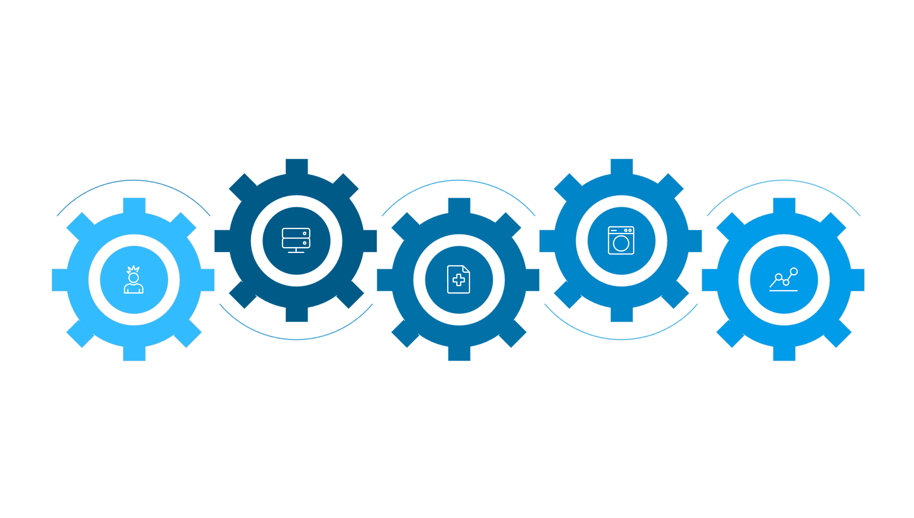





System Architecture Overview
A high-level view of how our platform's components interact to deliver powerful data insights.
API Server
AI Service
Express routes coordinating services
Analyze data, find patterns, suggest
User Interface
File Processor
Chart Generator
React front-end for uploads and filters
Validate, parse, and generate schema
Create charts and assemble dashboard
Technical Strengths
Performance
Error Handling
Security
Leverages data sampling, chart limiting, and progressive loading for rapid results on large datasets.
Ensures reliability with graceful fallbacks, robust validation layers, and clear user messages.
Implements file type validation, size limits, and secure session management to protect data integrity.
Made By MRO-Dev Team

Slide 8




Real-World Applications
Our AI Dashboard Platform is versatile, catering to diverse analytical needs across various sectors.
Business Analytics
Sales Reports: Track revenue by region. Marketing: Monitor campaign performance. Finance: Visualize expenses and profits.
Operations Management
Inventory: Stock levels and movement. KPI Monitoring: Track key metrics. Trend Analysis: Identify patterns over time.
Personal Use
Expenses: Personal finance management. Health Data: Fitness and wellness tracking. Projects: Task and milestone management.

Slide 9
Competitive Advantages
Our platform offers distinct benefits compared to traditional tools, making data analysis more accessible and efficient.
Ease of Use
✅ No learning curve
❌ Requires manual effort
❌ Steep learning curve
AI-Powered Insights
✅ Automated suggestions
❌ Manual analysis only
❌ Limited AI (depends on setup)
Setup Time
✅ Instant results
❌ Hours/Days for reports
❌ Weeks/Months for setup
Interactivity
✅ Real-time filtering
❌ Static charts
✅ High (but complex)
Cost Effectiveness
✅ No licenses needed
✅ Free (basic tools)
❌ Expensive licenses
Made By MRO-Dev Team

Slide 10
Future & Impact
We are continuously evolving our platform to offer even more powerful features and broader accessibility.
Expanded Connectivity
Advanced Analytics
Future plans include direct database connections (SQL) and real-time data updates for live dashboards.
Integrating statistical analysis and forecasting models
to provide deeper, predictive insights.
1
2
3
4
Enhanced Collaboration
Scalable Deployment
Introducing features for shared dashboards, allowing teams
to collaborate and edit reports seamlessly.
Implementing cloud deployment for robust scalability
and secure user authentication.
Thank You
Made By MRO-Dev Team
Empowering Data-Driven Decisions
Time Savings
Deeper Insights
Accessibility
Hours of manual work reduced to minutes, freeing up valuable resources.
AI uncovers hidden patterns, empowering better, faster decision-making.
Professional dashboards are now within reach for everyone, regardless of technical skill.
Thank you for your attention. Questions welcome!

